Slide 1
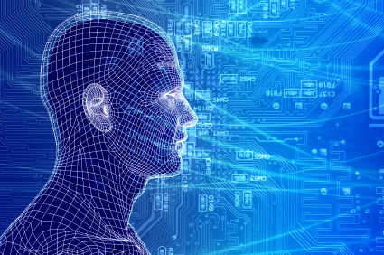
Cybersecurity and People: Challenges in Predicting User Actions
Joachim Meyer
Dept. of Industrial Engineering
Fleischman School of Engineering
Tel Aviv University

Slide 2
Humans
“Humans are incapable of securely storing high-quality cryptographic keys, and they have unacceptable speed and accuracy when performing cryptographic operations. (They are also large, expensive to maintain, difficult to manage, and they pollute the environment. It is astonishing that these devices continue to be manufactured and deployed. But they are sufficiently pervasive that we must design our protocols around their limitations.)”
−− C. Kaufman, R. Perlman, and M. Speciner. Network Security: PRIVATE Communication in a PUBLIC World. 2nd edition. Prentice Hall, page 237, 2002.

Slide 3
Some topics we study …
Risk taking in system use
There are several interrelated behaviors
Adjusting of system settings
People aren’t good at it
Responses to alerts and advice
Alerts are often ignored
Authentication

Slide 4
Model
Controlled Experiments
Observations in the Field

Slide 5
System Dynamics
Cost Benefit Analyses
Reinforcement Learning
???
Control Theory
Etc.

Slide 6
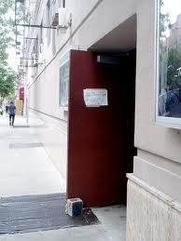
The Challenge of Access Control
Bank = b3aYZ
Amazon = aa66x!
Phonebill = p$2$ta1

Slide 7
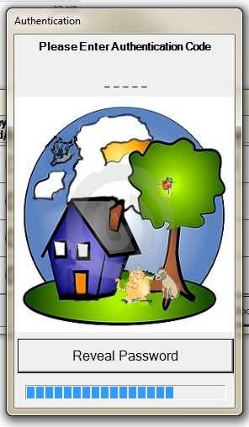
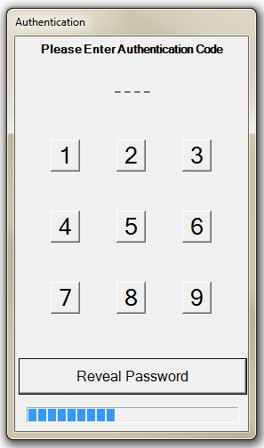
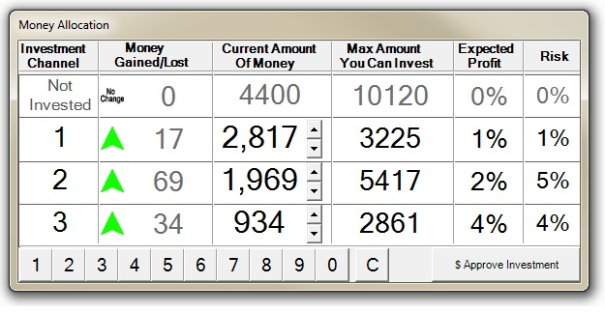
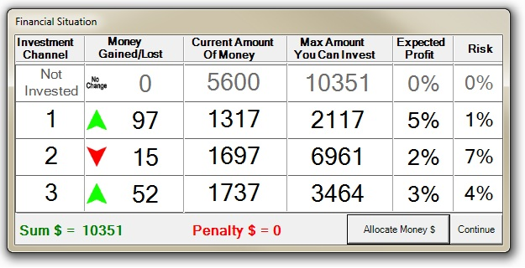

Slide 8
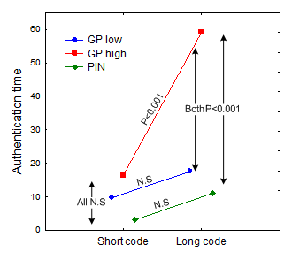
What affects authentication behavior?
Authentication method
(password, graphic, biometric)
Authentication complexity
(e.g., password length, required accuracy of movements)
Authentication frequency
Importance of protection
(likelihood and severity of threats)
Situation
(stress, time pressure, etc.)

Slide 9
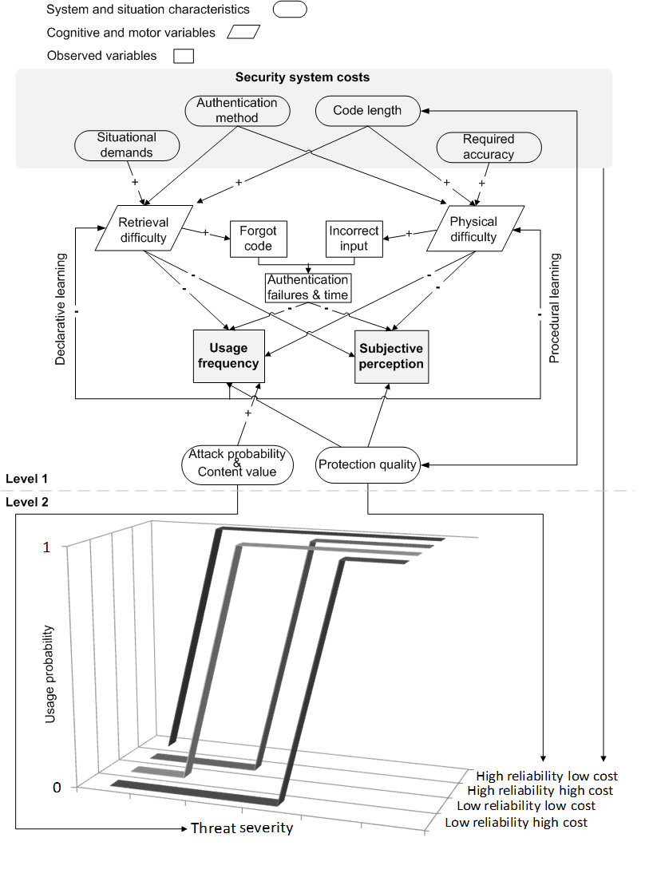

Slide 10
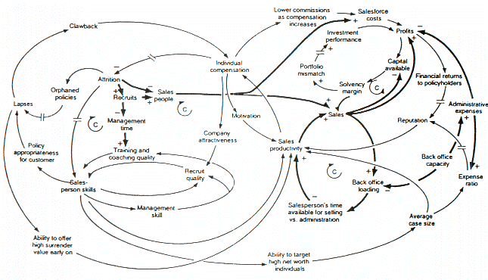
The big problem – matters are messy. Intentions, feedback, learning, communication

